Slide 1
MINI PROJECT 2 tcb management, basic scheduling, timing features
William Trace LaCour (WTL6C)

Slide 2
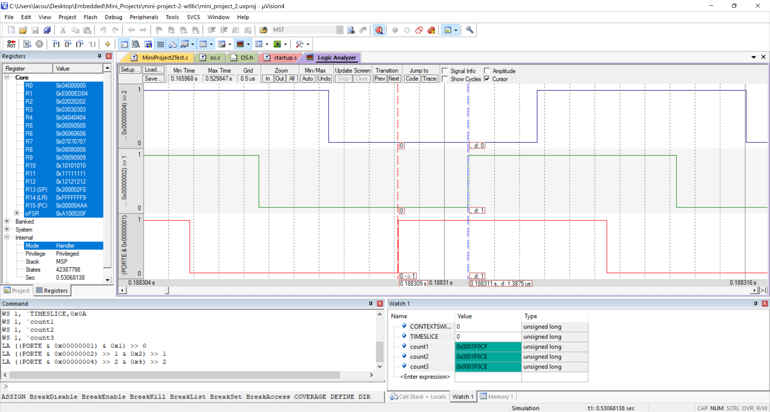
Deliverables for part 2a – Time slice
$$1.3875 μs=Time Slice+Context Switch Time$$
In the following slides, I will explain how to isolate the time slice. It requires that you know the context switch time, in this case I had to assume the context switch is the same as the one measured for TestMain0. Without changing the code you could not find the context switch time for TestMain1 but you could for TestMain2.

Slide 3



Deliverables for part 2a – frequency
$$Frequency (TestMain1)=\frac{1}{4.1625 μs}=240.240 kHz$$

Slide 4
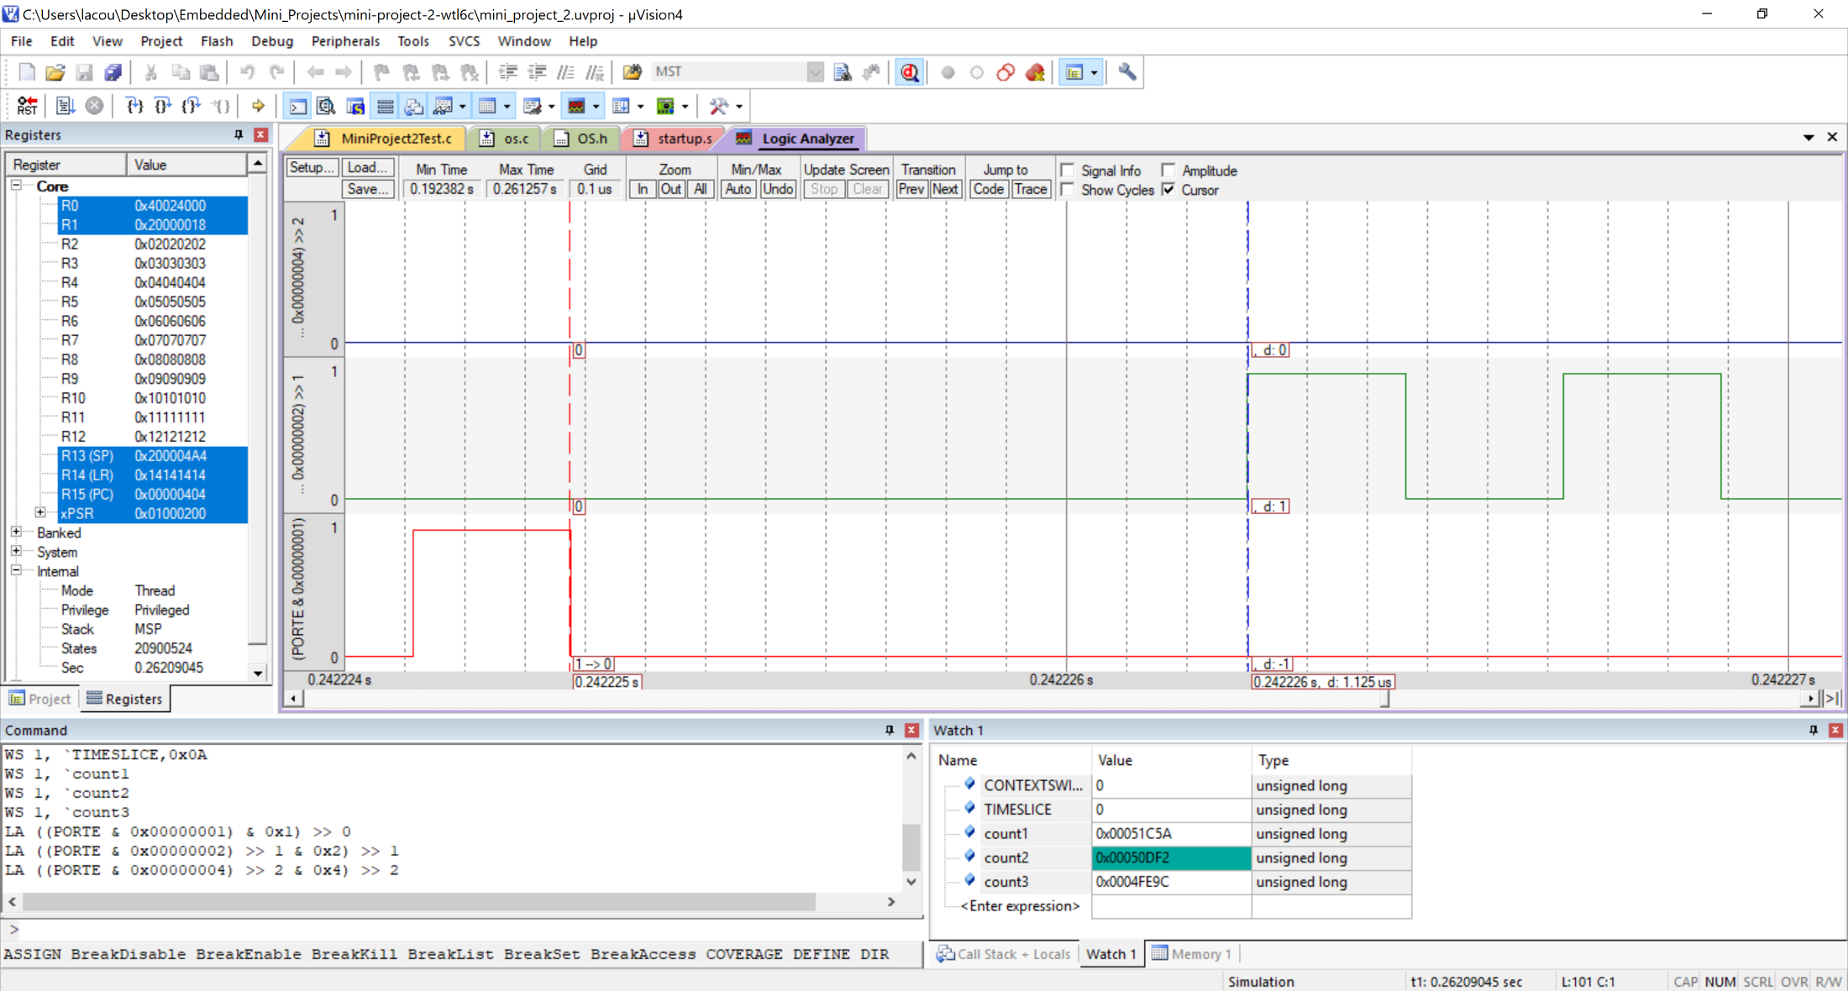

Deliverables for part 2b – Context Switch Time
$Context Switch Time$ = 1.125 µs

Slide 5
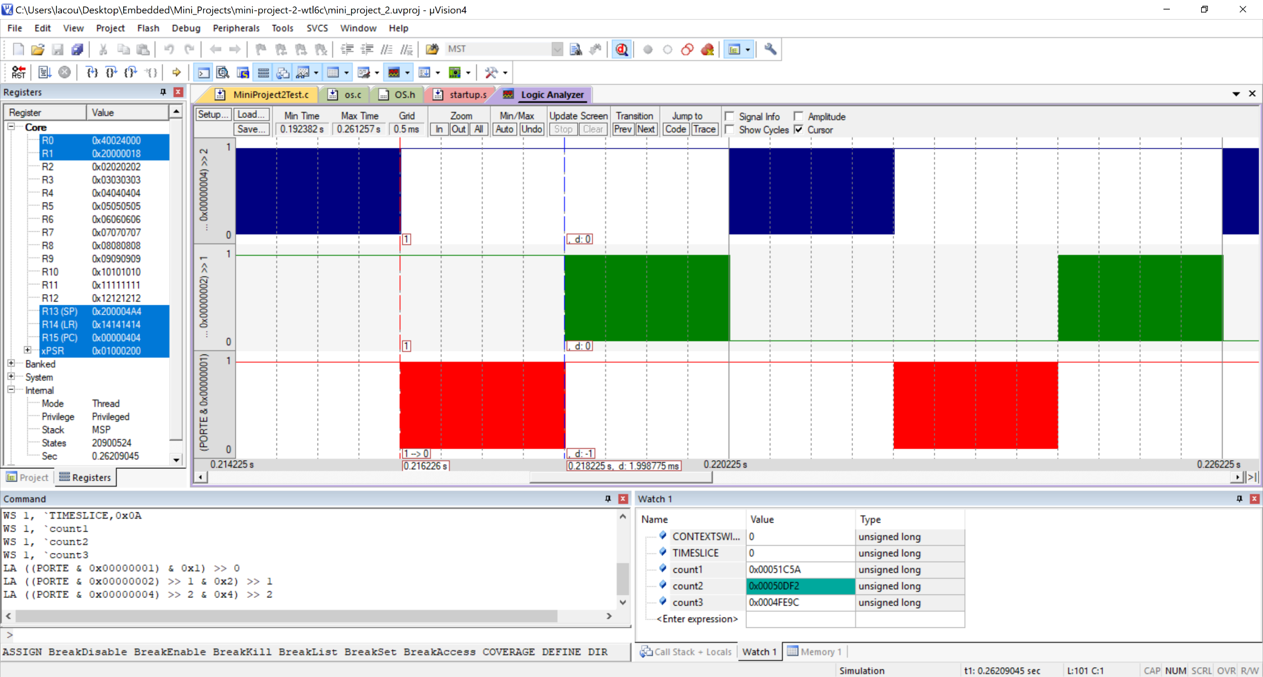

Deliverables for part 2b – Time slice
$$Time Slice=1.998775 ms$$
I zoomed in and found the last cycle before the context switch and measured that as my Time Slice. Adding the context switch time and the Time Slice should be roughly 2ms.

Slide 6
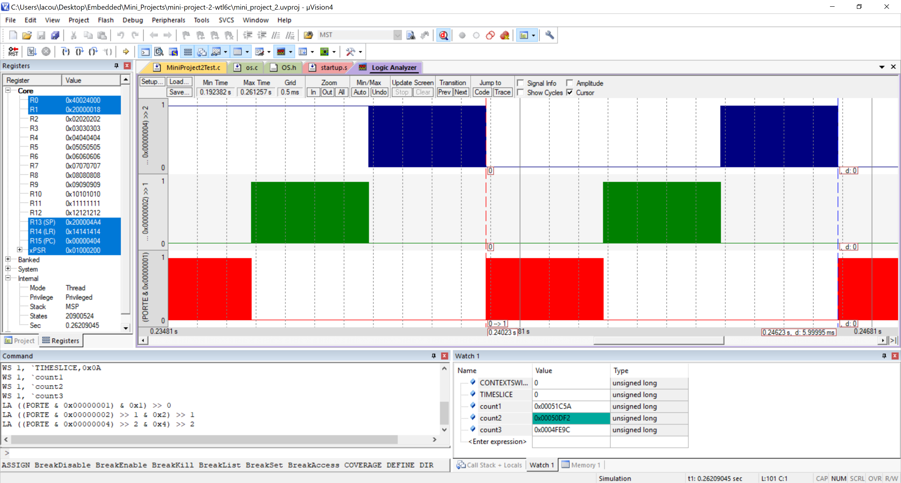

Deliverables for part 2b – frequency
$$Frequency (TestMain2)=\frac{1}{5.999995 ms}=166.67 Hz$$

Slide 7
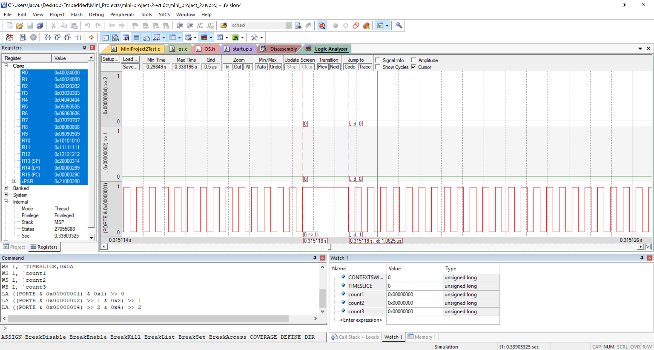
Deliverables for part 2c – context switch time
$$Context Switch Time(TestMain0)=1.0625 us$$

Slide 8

Deliverables for part 2 – Summary
We found that the context switch time, the time it takes from leaving one thread and going to another, was about :
1.0625 μs (TestMain0)
We also found that the total time to run a thread and context switch was about :
1.3875 μs for TestMain1 (one time through the thread)
Knowing these both, the time slice for TestMain1 can be found by the following :
$Time Slice \left(TestMain1\right)=$1.3875 μs – 1.0625 μs = 325 n
TestMain1
Frequency = 240.240 kHz
Time Slice = 325 ns
TestMain2
Frequency = 166.67 Hz
Time Slice = 1.998775 ms
TestMain0
Context Switch Time = 1.0625 μs

Slide 9
Deliverables for part 2D – question
Explain why the values of the counters will be much higher in TestMain2 than they were in TestMain1.
The counter values were higher in TestMain2 because TestMain2 was allowed to run for 2ms where a interrupt would then switch to the next thread. TestMain1 was only allowed to run 1 time before manually switching to the next thread via the OS_Suspend() function. The fact that the TestMain2 got to run a lot longer before switching allowed for the values of the counters to increase to a higher value in a shorter amount of time.

Slide 10
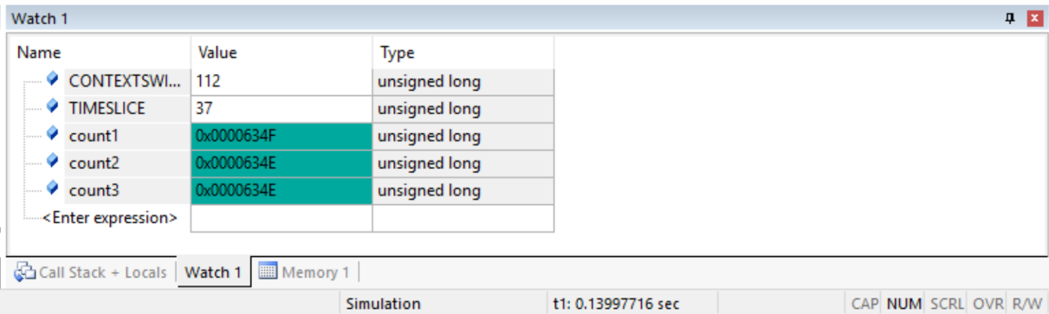
Deliverables for part 4a – Testmain1
TestMain1
Context Switch Time = 112 * 12.5 ns = 1.4 µs
Time Slice = 37 * 12.5 ns = 462.5 ns
Overall values were close to that of Part 2, just more instructions, making the overall time longer

Slide 11
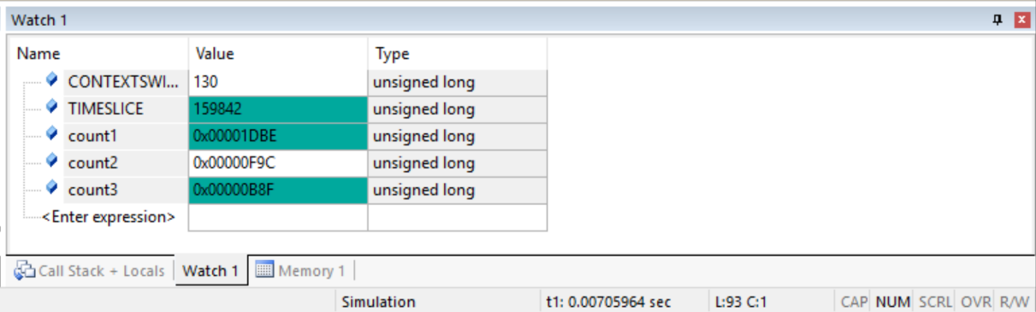
Deliverables for part 4a – Testmain2
TestMain2
Context Switch Time = 130 * 12.5 ns = 1.625 µs
Time Slice = 159842 * 12.5 ns = 1.998025 ms
Overall values were close to that of Part 2, just more instructions, making the overall time longer

Slide 12
Deliverables for part 4B – Question #1
Are there any differences between the values you measured using logic analyzer versus the measurements using OS_Time functions? Explain why.
Yes, the reason being that if you were to look at the difference in the assembly breakdown there is simply more instructions that need to be run now that we have function calls to OS_Time and OS_TimeDifference. Granted it won’t be much of a difference, a couple microseconds at most.

Slide 13
Deliverables for part 4B – Question #2
Are there any differences between the values you measured in Testmain1 versus Testmain2 function? Explain why
Yes, TestMain1 had a smaller Time Slice than TestMain2 because it was only allowed to run once versus that of TestMain2 which had the entirety of the 2 ms. The context switch value was roughly the same, with only a few microseconds difference. Overall the context switch should be about the same but the Time Slice, the time a thread is allowed to run, is different because one uses OS_Suspend and one simply waits for the interrupt.

Slide 14
Deliverables for part 4B – Question #3
Explain the purpose of using Timer1A, Timer2A, Timer3A, and Timer4A in this mini project.
Timer1A – used to run periodic tasks (runs in the background)
Timer2A – used when OS_Suspend triggers SysTick Interrupt as well as the when OS_Launch sets the interrupts and timers.
Timer3A – used to keep the system time via OS_Time
Timer4A – used to run periodic tasks (runs in the background)

Slide 15
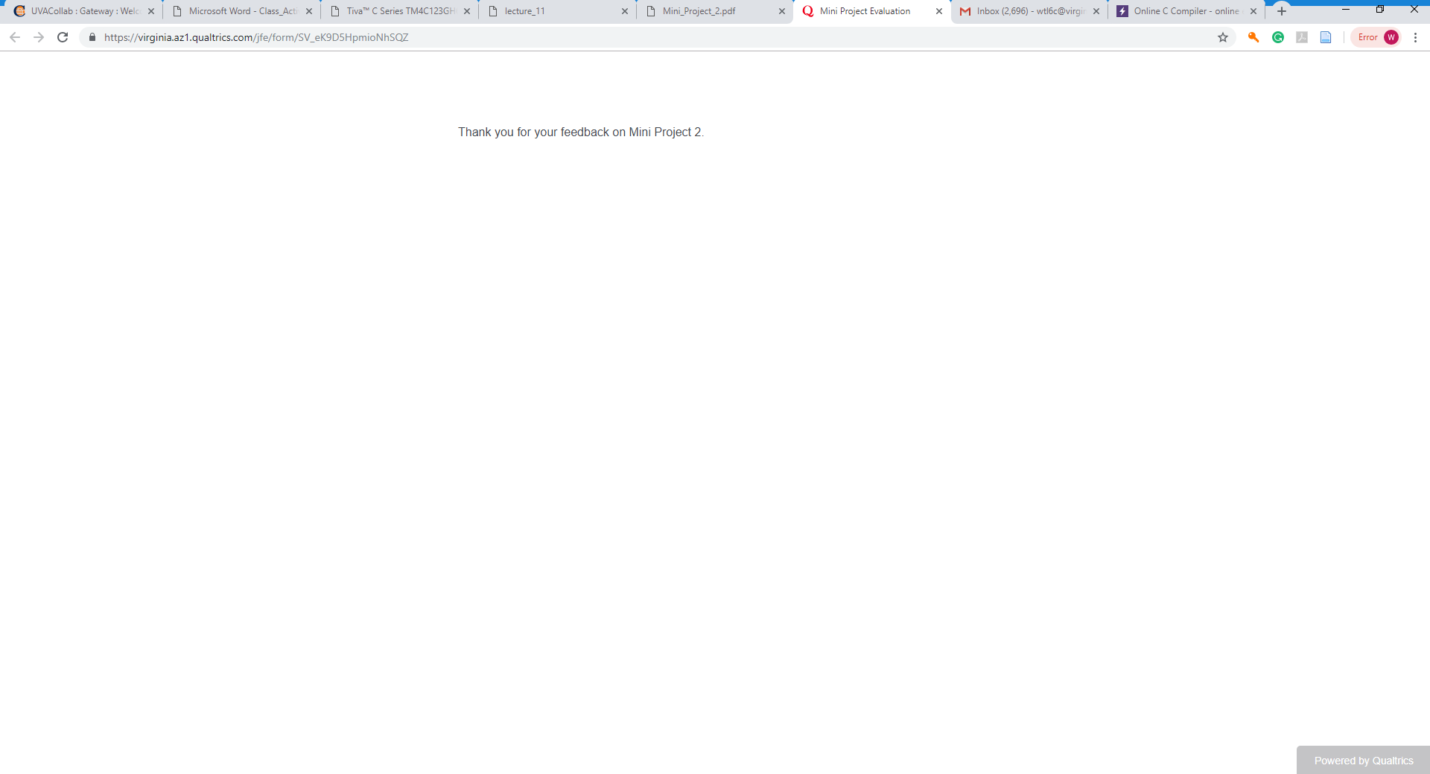
Survey screenshot

